Slide 1
Histograms
From last lesson:
Find the mean, median, mode and range for the following data set:
4, 8, 9, 9, 9, 10, 14, 16
EQ: How do we create histograms?
Miss L
Year 8

Slide 2
Glossary Builder – each group will be responsible for defining one of our key words
Word:
Definition:
Census:
Population:
Sample:
Median:
Mean:
Mode:
Categorical data:
Numerical data:
Bias:
Outliers:
Notes:
All of the words except for bias and outlier should have been covered already. Give each group the responsibility to define as a group (using textbooks and notes) and then write on the board their definition. As a class add the definitions for bias and outliers.
Bias: unfair sampling. The sample does not represent the population
Outliers: values that are noticeably different than the rest of the data
Take a photo of the board and upload to connect for the students if they do not write them all down in time.

Slide 3
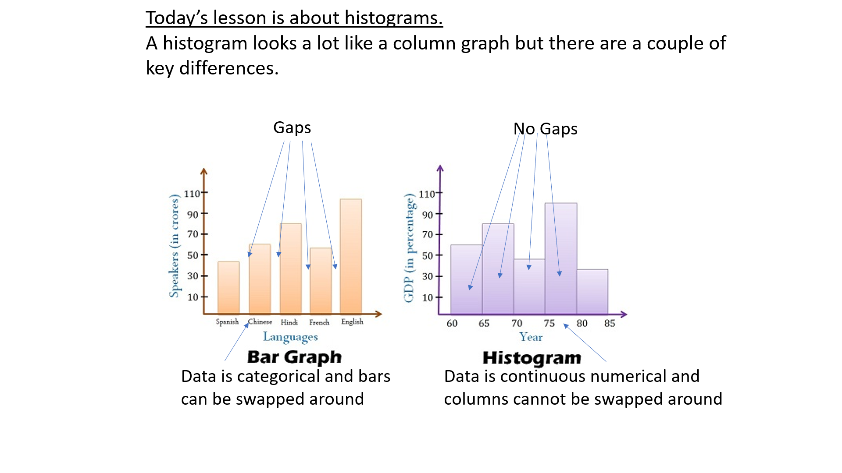
24
7
30
Histograms
Histograms look very similar to bar graphs
Date
EQ – How do we create histograms?
What is a histogram?
A histograms shows the frequency of continuous numerical data.
List the steps to create a histogram
Look at the range of the data to help decide on a “class width”.
Ex. If you have data from 1 – 100 you wouldn’t want a class width of 2 (50 groups) but maybe a width of 10 (10 groups)
Use the class width to create a frequency table.
Create a set of Axis that will accommodate all the data.
Use the frequency data from the frequency table to complete the graph and add a title.
Are you Frequently correct?
We will do a quiz to see if you are and then make a histogram! Put the numbers 1-10 on your LHS
Notes:
You need the printed off histogram activity pages 3-4 for each student. Ask them the questions and then mark all the answers and collect the data on the board. After creating the frequency table create the histogram then have students go back and answer the questions.

Slide 4
Summary:
Histograms display______________________________ data without any _______________.
To create histograms we need to decide on appropriate _________________ and then create a ______________ table.
Notes:
Histograms display continuous numerical data without any gaps. To create histograms we need to decide on appropriate class width sizes and then create a frequency table.

